Slide 1

DS – Project work 1. Data Exploration/Analysis
27 February 2021

Slide 2
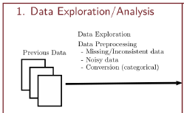


Focus on Missing values or out of the Domain
CRM, FINANCE, SALES, TWITTER
CRM
Missing Values:
-116 MDR_Low_Grade;
-116 MDR_High_Grade NA(Is it not available?);
-596 First Meeting, Last Meeting, DifferenceTraveltoFirstMeeting, DifferenceTraveltoLastMeeting;
-159 SchoolSizeIndicator;
-4 CRM_Segment
Values out of the Domain
-Poverty_Code=0 (1053 records with 0)
-SchoolGradeType, SchoolGradeTypeHigh, SchoolGradeTypeLow = Undefined
-Income_Level=0
-School Type=CHD
-MDR_Low_Grade=K,PK
FINANCE
Missing Values:
- 3322 Special_Pay NA(Is it not available?)
Values out of the Domain
-Special_Pay=0
-ID_FINANCE= 1389,3090,3639,4249
SALES
Missing Values:
-226 From_Grade; -16 Initial_System_Date
-269 To Grade; - 159 FPP_to_School_enrollment
-1168 Early_RPL; -37 Last_RPL;
Values out of the Domain
-GroupGradeType, GroupGradeTypeHigh, GroupGradeTypeLow= Undefined
-Group State=Bermuda
-GroupGradeTypeLow= K, PK

Slide 3
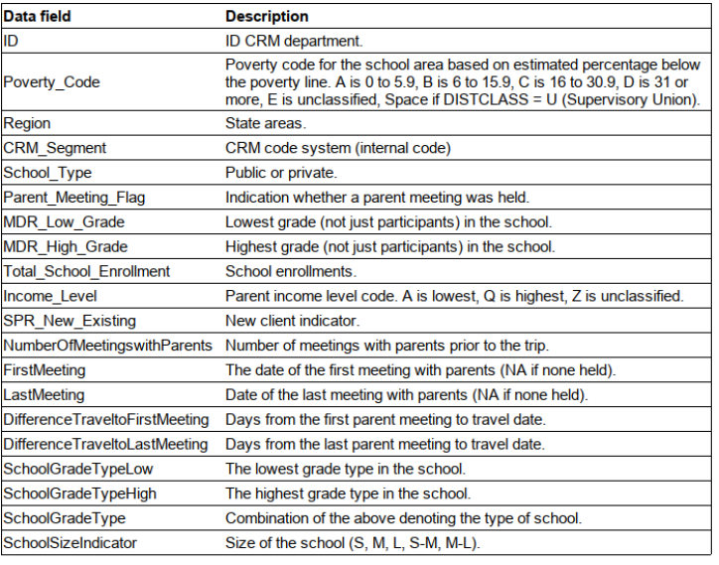
Focus CRM Dataset
CRM Domain Table

Slide 4
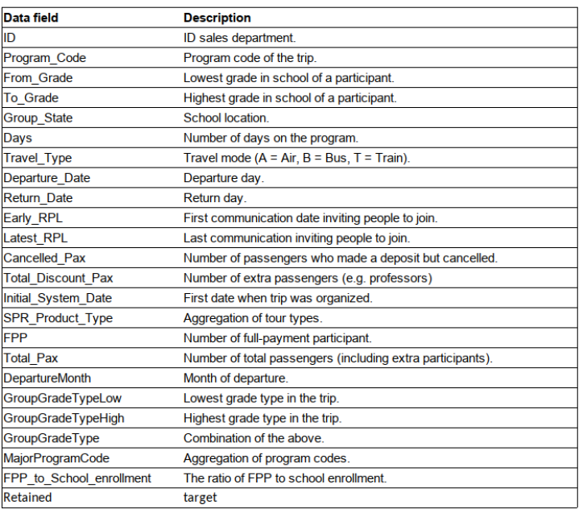
Focus SALES Dataset
SALES Domain Table

Slide 5
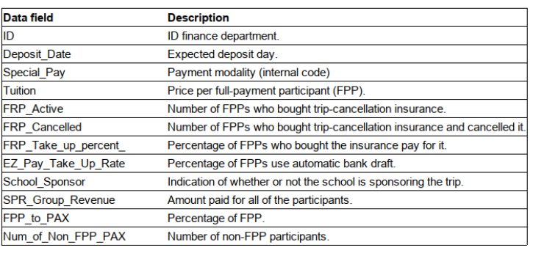
Focus FINANCE Dataset
FINANCE Domain Table

